Slide 1
Secure Spectrum Sensor Using MQTT Protocol
Group #4
Members: Rajib Dey, Debashri Roy, Cody Baker, Kennedy Vrutaal

Slide 2
Content
What is a spectrum Sensor ?
Why Spectrum Sensor IoT?
Where is the Security?
Overview of the Project
Project Flowgraph
Collected Data
Demo Video of the Project
Conclusion & Future work
Q & A

Slide 3
What is a spectrum Sensor ?
Can “Sense” a range of Spectrum Our sensor R820T SDR by NooElec has a range of 25MHz to 1750MHz
Commercially available from least expensive to more expensive ($15-$4000+) Our sensor cost about $19 per piece

Slide 4
Why spectrum sensor IoT?
Controlling is important for commercial and academic use
Can control frequency-range from other devices over Internet
Useful in Dynamic Spectrum Access (DSA) implementation and other research work on wireless communications
Useful to store data in Spectrum Database

Slide 5
Where is the security?
Implemented MQTT for collecting data over the Internet
Data consists of:
RSSI (Received Signal Strength Indicator) values in dB at particular frequency
GPS location ( Latitude and Longitude value)
Date time
Implemented certificate based TLS communication for MQTT
Used a TCP socket connection to control frequency range from different device
Implemented certificate based TLS communication for TCP socket connection

Slide 6



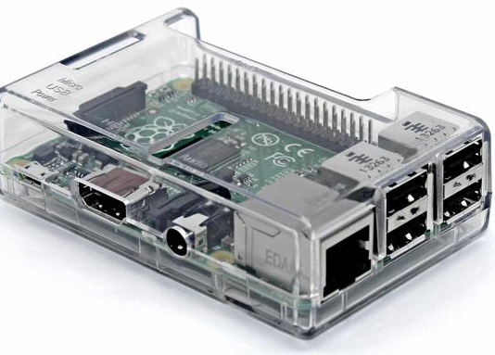

Overview of the Project
GPS Module
Sensor
Laptop/PC
TCP protocol using Certificate based Mutual Authentication
Controller
Preferably over strong Wi-Fi Signal
Server
RaspberryPi
MQTT Protocol using Certificate based Mutual Authentication

Slide 7

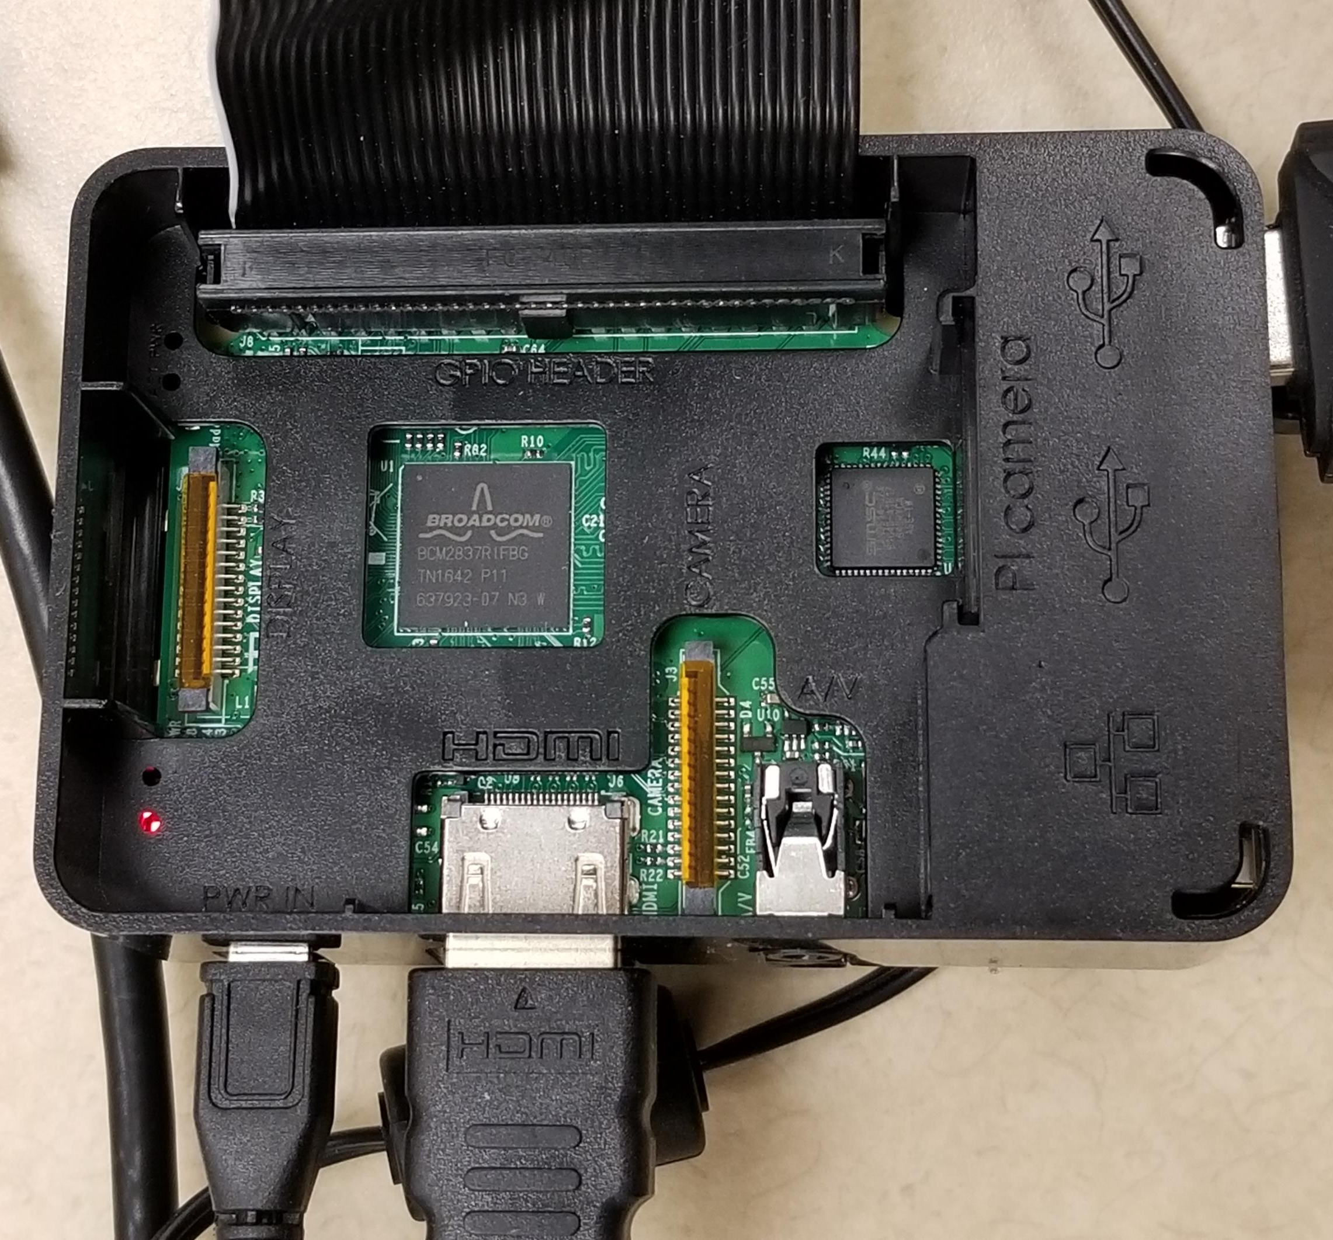
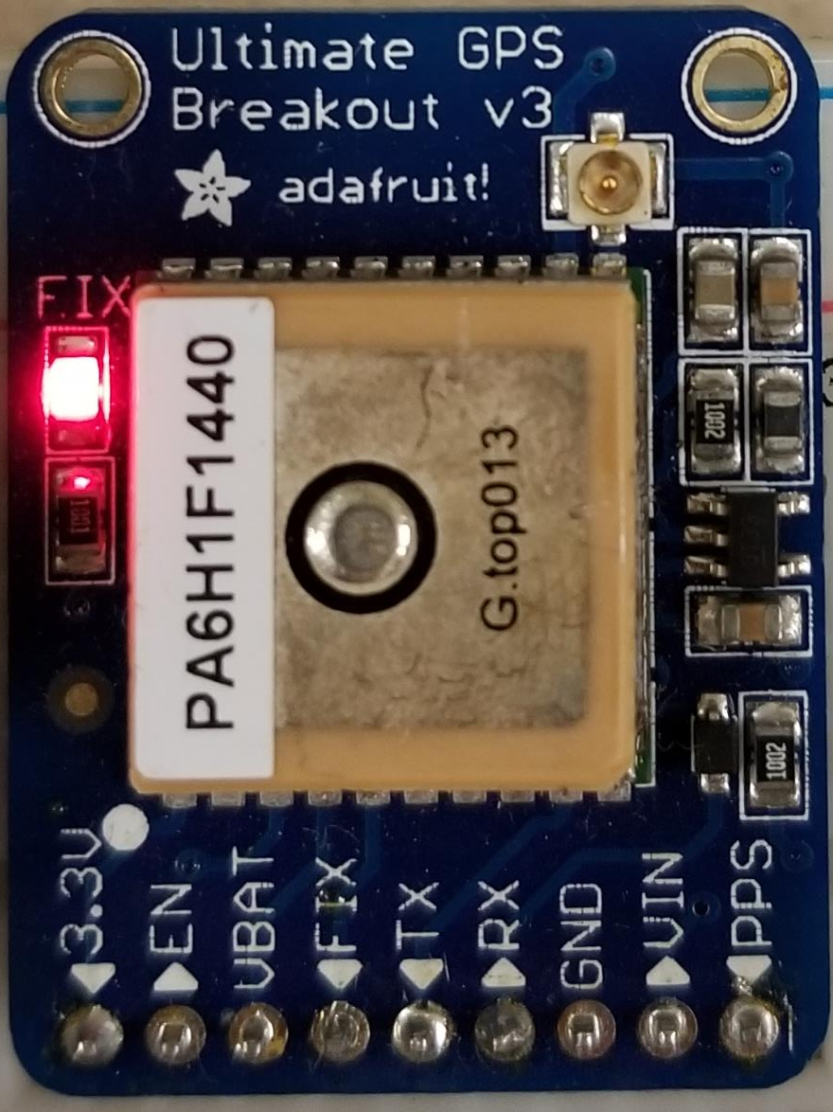
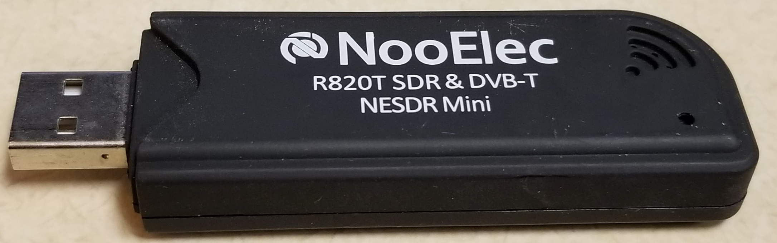
Project Overview: Equipment
Raspberry Pi
GPS Module
Adafruit Ultimate GPS Breakout MTK3339
Spectrum Sensor
NooElec R820T Mini SDR
Controller Device
Laptop
Data collection/Server Device
Laptop

Slide 8
Project Flowgraph
Connect the Pi to Wi-Fi
Connect the laptop to Internet or the same Network
Data Collection
Use data
Connect the Sensor to the USB port
Data is collected and saved in the excel file
For future Research purposes
Have the server and Controller Up and Running
Connect the GPS module
An Optional Graph is generated inside the Excel file
Eliminating Dead zone etc.
Run the python controller program to control sensor
Install Necessary software on the Pi
Run the python program to collect data
Run the python program

Slide 9
Collected Data
Day 1: Set 1
Frequency Range: 55MHz-65MHz
Outdoor: UCF Campus
Duration: 1 Hr
Date: 21st Nov, 2017

Slide 10
Collected Data
Day 1: Set 2
Frequency Range: 55MHz-65MHz
Outdoor: UCF Campus
Duration: 1 Hr
Date: 21st Nov, 2017

Slide 11
Collected Data
Day 2:
Frequency Range: Variable
Indoor: HEC 313
Duration: 24 Hrs
Date: 25th-26th Nov, 2017

Slide 12
Conclusion & Future Work
Conclusion
Implemented Secure Spectrum Sensor using MQTT protocol
Controlling the Spectrum Sensor over secure TCP Connection
Collected data and saved it for later use
Future Work
Use USRP B/N series for wider range of Spectrum Sensing
Implementation of Spectrum database for dynamic data collection and use

Slide 13
Q & A
Questions?

